Slide 1

MODULE: WORKSHOP TECHNOLOGY
Code: TWP1161

Slide 2
MODULE: WORKSHOP TECHNOLOGY
LESSON: ELECTRICAL WORKSHOP TECHNOLOGY
Part I
PREPARED BY: T . SILAS

Slide 3
INTRODUCTION
This course will provide you with practical skills that are used in electrical installation and are ideally suited to school leavers who wish to become electricians working in the maintenance or installations trades.
You will be assessed through the completion of various training activities as well as an externally set knowledge test. With further studies in this area, you may have the opportunity to progress to technician testing engineer or design.

Slide 4
INTRODUCTION Con,t
  MODULE PURPOSE
The module unit is designed to equip the trainee with: knowledge, skills and attitudes that enable him/her to perform basic workshop tasks.
  GENERAL OBJECTIVES
At the end of the module unit, the trainee should be able to:
Understand safety regulations in the workshop
Identify tools and materials to be used in a conventional workshop
To acquire skills in basic engineering practice.

Slide 5
INTRODUCTION Con,t
  WHAT IS WORKSHOP?
Workshop is a room, area, or small establishment where manual or light industrial work is done. It can be also a room or building in which manufacturing or other forms of manual work are carried on
A training workshop is a type of interactive training where participants carry out a number of training activities rather than passively listen to a lecture or presentation

Slide 6
SAFETY
Electricity is a useful and powerful tool in our daily life. Everything around us works with electricity such as lamps, TVs, computers and mobile phones. Today, electricity has become such an essential part of our life that it is difficult to imagine life without it. Figure below shows examples of equipment that work on electricity, which demonstrate the importance of electricity in our daily life.

Slide 7
Examples of equipment that work on electricity

Slide 8
Examples of the dangers of electricity
However, electricity is very dangerous. It can cause shock, burn or kill you. Electricity can also damage sensitive devices. This module covers the basic safety rules and practices that apply at home, outdoor, labs and workshops

Slide 9
  Home Safety
To protect your home from electrical risks and hazards, you need to follow some home safety
DON'T overload plugs as this can cause electrical fire
Never use an electrical appliance in a wet area. This can cause an electric shock

Slide 10
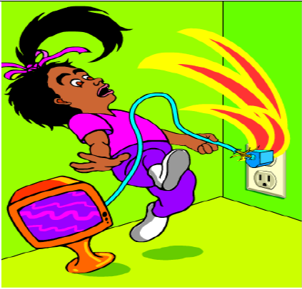
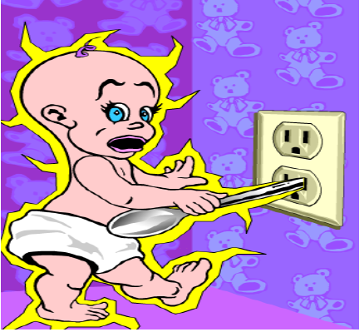
Home Safety Con’t
DON’T pull on the cable to remove a plug from the socket. This can damage the insulation and cause an electric shock or an electrical fire.
Never allow children to play with outlets. Inserting conductors in an electrical outlet is dangerous and can cause shock, which can kill a person.

Slide 11
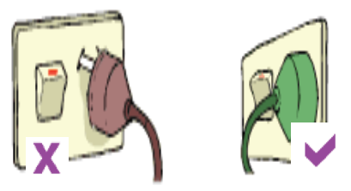
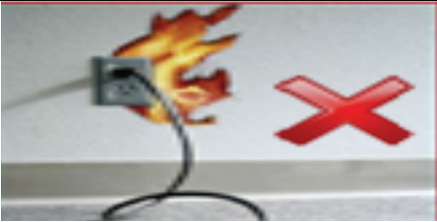
Home Safety Con’t
Plugs should be pushed carefully all the way into the power points.
Replace the socket outlet if the plug is loose in the socket or if it shows signs of damage

Slide 12
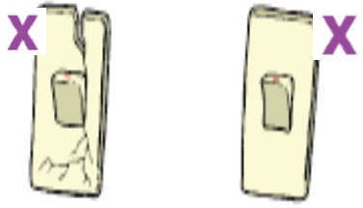
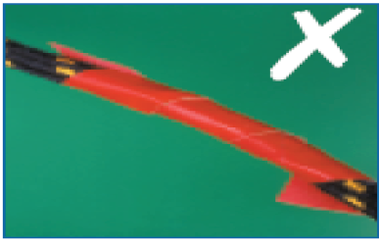
Home Safety Con’t
DON’T make joints in a cable; replace it with one of adequate length
Switches and power points should not be cracked, broken or loose.

Slide 13
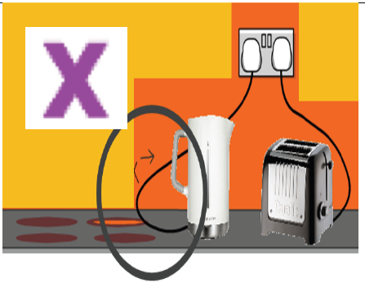
Home Safety Con’t
DON’T let leads from electrical equipment, such as toasters or kettles, trail across your cooker tops
Always use plug protectors to stop small children from pushing things such as keys and pins into the power outlet.

Slide 14
OUTDOOR SAFETY
There are many outdoor electricity sources that can cause electricity hazards such as high voltage power lines, electricity substations and transformer boxes. To avoid accidents and protect yourself from electrical injuries, follow the next tips:

Slide 15
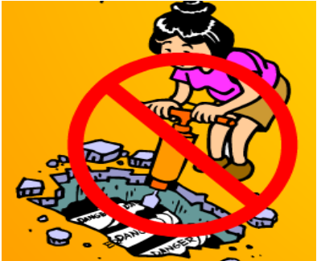
OUTDOOR SAFETY Con’t
WHILE WORKING
Never bring ladders, long handled tools or other items within 10 feet of an overhead power line
Never touch the underground power lines.

Slide 16

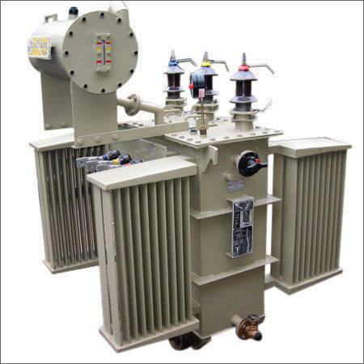
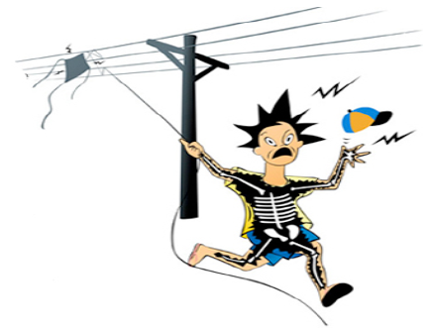
OUTDOOR SAFETY Con’t
WHILE PLAYING
Never play with transformers because they carry high voltages that can be deadly
Never fly kites or model airplanes near electric power lines

Slide 17

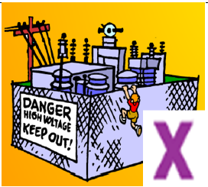
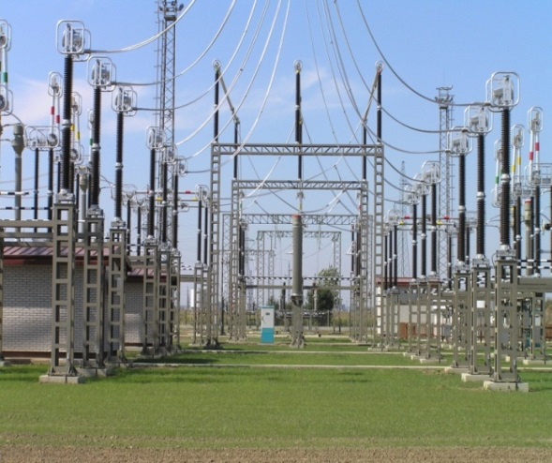

OUTDOOR SAFETY Con’t
DON'T play near live power lines. If you see a downed power line, stay as far away as possible and keep others away.
DON'T play near electricity substations. They contain powerful electrical equipment that is dangerous
DON'T climb trees that are near power lines. This can seriously injure you

Slide 18
LABS & WORKSHOPS SAFETY
Before you can use equipment and machines or attempt practical work in a workshop or a lab, you must understand basic safety rules. Following safety rules will prevent you and others from accidents, injuries as well as death. To avoid accidents and injuries in the workshops and labs, follow the next safety rules and practices:

Slide 19
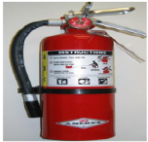
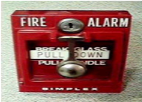
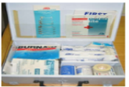

LABS & WORKSHOPS SAFETY Con’t
Before conducting workshop tasks, be familiar with the location of:
Fire extinguishers
Fire alarm pull stations
First aid kits

Slide 20

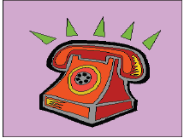
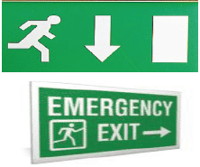
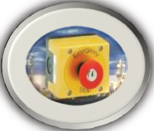
LABS & WORKSHOPS SAFETY Con’t
Emergency telephone numbers.
Emergency exits.
Emergency stop button.
Smoking, eating or drinking are not permitted in labs and workshops

Slide 21
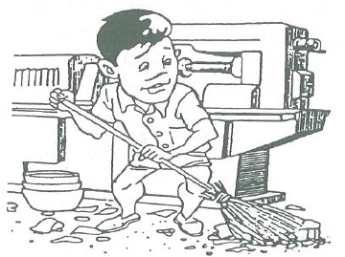
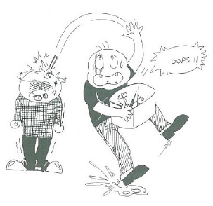
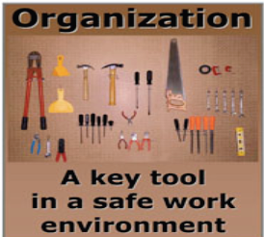
LABS & WORKSHOPS SAFETY Con’t
Keep the workshop clean and tidy at all times
Keep the workshop floor dry
Keep your tools and work area organized

Slide 22
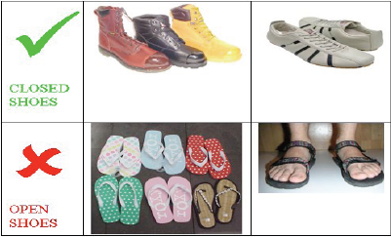

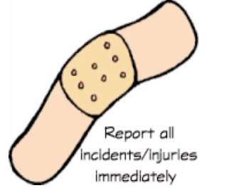
LABS & WORKSHOPS SAFETY Con’t
Report accidents such as spells, burns, cuts or injuries to the teacher immediately
Wear safety shoes while working in a workshop. Sandals or slippers are not allowed in workshops
Keep your lab bench organized and free of bags and books

Slide 23
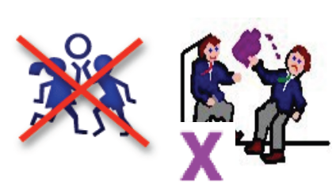


LABS & WORKSHOPS SAFETY Con’t
Always use the appropriate personal protective devices and check that they are clean and in good condition.
Listen carefully to all instructions and lab procedures from your teacher. Ask questions if you aren't sure.
Don’t joke or play with your friends inside the lab

Slide 24
ELECTRIC SHOCK
Electric shock is the physiological reaction or injury caused by electric current passing through the human body
You will get an electrical shock if a part of your body completes an electrical circuit by:
Touching a live wire and an electrical ground
Touching a live wire and another wire at a different voltage.
The severity of electric shock depends on the following factors:
Path of current through the body
Amount of current flowing through the body (amps)
Duration of the current flow through the body

Slide 25
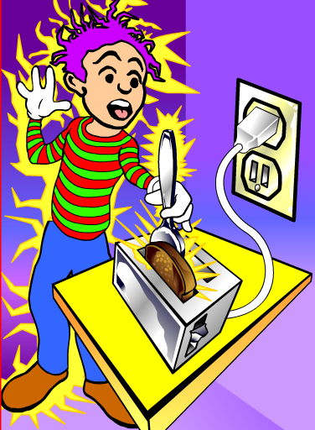
ELECTRIC SHOCK Cont’

Slide 26
ELECTRIC SHOCK Cont’
  DANGER TO MAN BY ELECTRIC CURRENT
It takes about 30-50mA to kill a human being.
The amount of current depends upon:
The person involved and his state of health.
The area of the body involved.
The length of time the shock is received.
The type of current involved.
Important factors that contribute to the severity of shock
Age of person
Not wearing insulated footwear wet footwear
Weather condition
Floor is wet or dry
Main voltage.

Slide 27
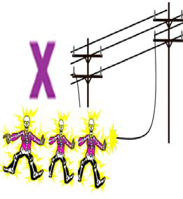
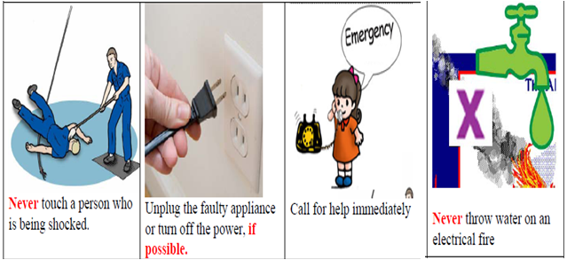
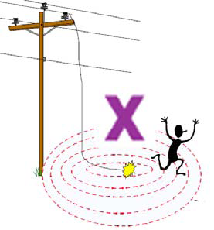
ELECTRIC SHOCK Cont’
HOW TO ACT IN ELECTRICAL EMERGENCY SITUATIONS
Do not touch anything, or anyone, that is touching a downed wire
Stay away from all downed wires even if there are no sparks.

Slide 28
ELECTRIC SHOCK Cont’
  HOW TO AVOID ELECTRIC SHOCKS
Use proper precautionary measures and recommended safe practices at all times by following these instructions:
Read all instructions and labels before installing, operating, or servicing the equipment.
Do not touch live electrical parts. Have all installation, operation, maintenance, and repair work performed only by qualified people.
Properly install and ground the equipment and machines.
Do not work alone where there are electrically hazardous conditions.
Do not wrap cables carrying electric current around any part of your body.
Do not experiment! Do not touch a wire with your finger to see what will happen

Slide 29
FIRE EXTINGUISHERS
Fires are divided into Four Classes or Categories
◆ Class A are wood, paper and textile fires
◆ Class B are liquid fires such as paint, petrol and oil
◆ Class C are fires involving gas or spilled liquefied gas
◆ Class D are very special types of fire involving burning metal
Various things can be used to put out the fire.
Water
Sand or dry soil
Foam extinguishers
Carbon dioxide extinguishers
Dry powder extinguishers
Fire blankets

Slide 30
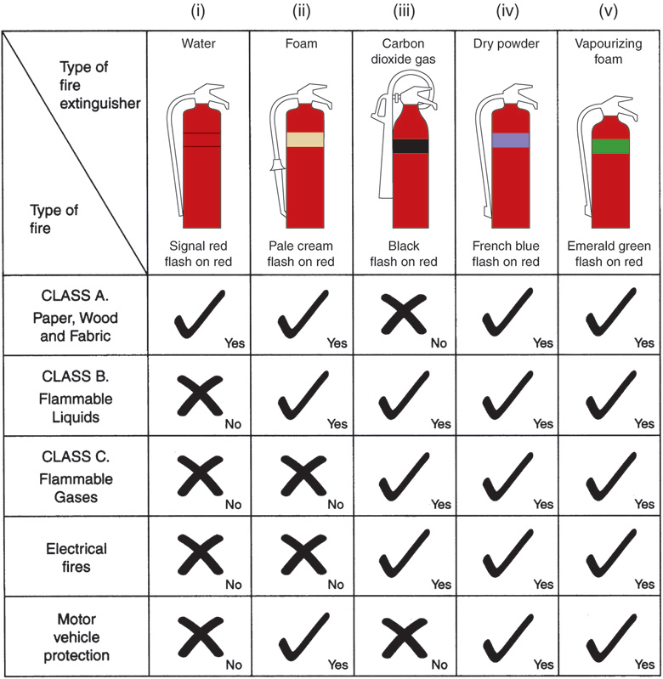
FIRE EXTINGUISHERS Cont’

Slide 31
FIRE EXTINGUISHERS Cont’
In the event of a fire you should
◆ raise the alarm
◆ turn off machinery, gas and electricity supplies in the area of the fire
◆ close doors and windows but without locking or bolting them
◆ remove safely combustible material away from the path of the fire
◆ attack small fires with the correct fire extinguisher
The first role to deal with electrical fire is to turn off first the circuit

Slide 32
INTRODUCTION TO ELECTRICITY
Electricity has become very useful and has changed everyone's life since the day it was discovered. Electricity is something that people cannot live without in the modern day. Without it, life will be so much difficult and slow. Electricity is a vital part of functioning of society. Simple tasks, such as factories, phones computers and refrigerators need electricity. Electricity is generated from different sources called power stations such as wind power station, hydropower station, thermal power station solar power and battery power. Figures below show the sources of electricity and how electricity reaches your home.

Slide 33
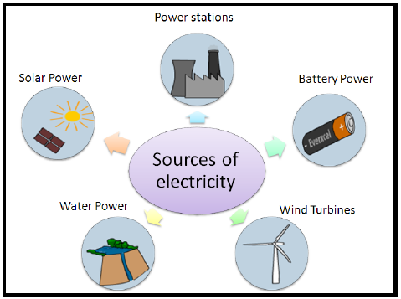
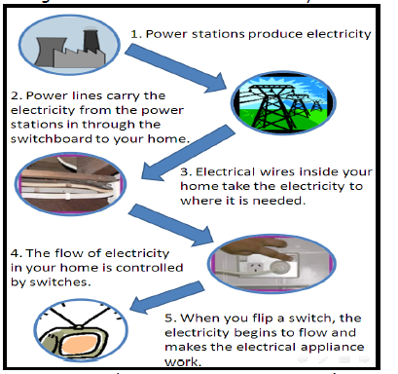
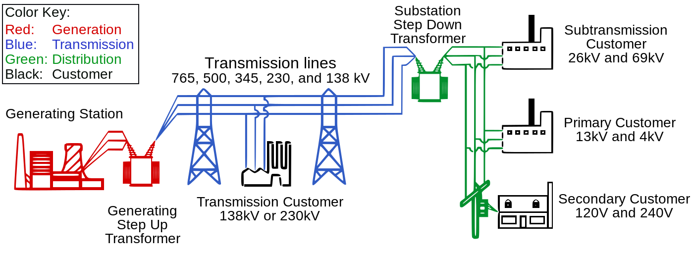
INTRODUCTION TO ELECTRICITY Cont’

Slide 34
INTRODUCTION TO ELECTRICITY Cont’
BASIC ELECTRICAL TERMS
Electricity: is a form of energy or Electricity is the flow of free electrons. Electricity is one of our most widely used forms of energy. We get electricity, which is a secondary energy source, from the conversion of other sources of energy, like coal, natural gas, oil, nuclear power and other natural sources.
Current (I): An electric current is a flow of electric charge in electric circuits this charge is often carried by moving free electrons in a conductor. It can be also movement of free electrons through the conductor. It is measured in amperes (A) by an Ammeter.

Slide 35
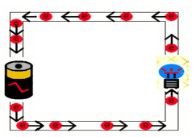
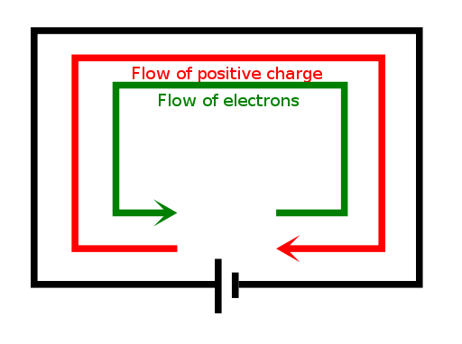
INTRODUCTION TO ELECTRICITY Cont’
Conventional Flow: This theory states that electrons flow from negative to positive and electricity tend to flow through a wire from the positive to the negative.

Slide 36
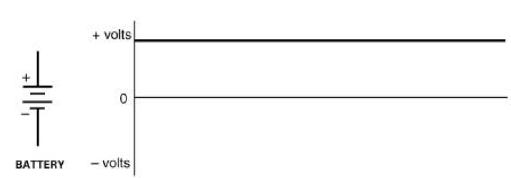
INTRODUCTION TO ELECTRICITY Cont’
Direct current: The voltage forces the electrons to flow continuously in one direction through a closed circuit. This type of voltage is called Direct Current (DC) voltage. Batteries and DC generators produce DC voltage.
Alternating current: The voltage forces electrons to flow first in one direction, then in the opposite direction, alternating very quickly. This type of voltage is called Alternating Current

Slide 37
INTRODUCTION TO ELECTRICITY Cont’
Voltage (V): The definition of voltage is the electromotive force or the electrical potential difference between two points in a circuit. It can be also the force (pressure) that is applied to a conductor to free electrons, which causes electrical current to flow. It is measured in volts (V) by a Voltmeter.
Resistance (R): Resistance is the opposition that a substance offers to the flow of electric current. It is represented by the uppercase letter R. The standard unit of resistance is the ohm, and is measured in ohm (Ω) by an Ohmmeter.

Slide 38


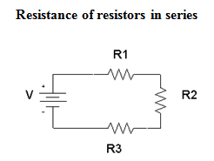
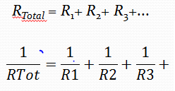
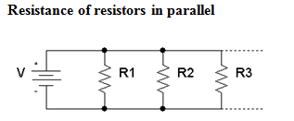
INTRODUCTION TO ELECTRICITY Cont’
Resistance calculation
The resistance of a conductor is resistivity of the conductor's material times the conductor's length divided by the conductor's cross-sectional area.
Resistance calculation with ohm's law
Temperature effects of resistance
R₂ = R₁ × (1 + α (T₂ - T₁) )

Slide 39
INTRODUCTION TO ELECTRICITY Cont’
Conductors: Materials that allow electric current to flow easily they contains many free electrons. Example: gold, copper, silver, aluminum.
Insulators: Material that does not allow electric current to flow is an electrical insulator or dielectric, they contain few free electrons. These materials are used in parts of electrical equipment, intended to support or separate electrical conductors without passing current such as; dry wood, plastic, rubber, glass, paper etc.
Semi-conductor: These are materials having properties is both conductors and insulators.
Example: Silicon, Germanium

Slide 40
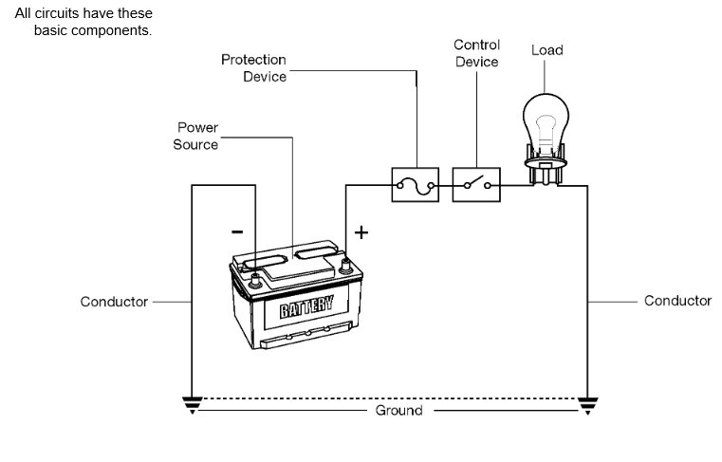
INTRODUCTION TO ELECTRICITY Cont’
Circuit: Complete path of the current. It consists of electricity source, a conductor, and the output device or load (such as a lamp, or a heater).

Slide 41
INTRODUCTION TO ELECTRICITY Cont’
Series circuit
A series circuit has only one path for current. That means current is the same through every part of the circuit. If any part of the circuit is broken or disconnected, the whole circuit will stop working. No current is present in a series circuit unless there is continuity through the entire circuit
A series circuit has these key features:
Current is the same in every part of the circuit.
The sum of all the individual resistances equals the total resistance in the circuit.
The sum of the individual voltage drops in the circuit equals the source voltage.

Slide 42
INTRODUCTION TO ELECTRICITY Cont’
Parallel circuit
A parallel circuit has these key features:
Total current equals the sum of the branch currents.
Resistance of each branch determines the current through each branch.
If the branch resistances are the same, branch currents will be the same.
If the branch resistances are different, the current in each branch will be different.
The voltage drop across each load resistance is the same. This is because the source voltage is applied equally to each branch.
The equivalent resistance of the circuit is less than the smallest branch resistance.

Slide 43
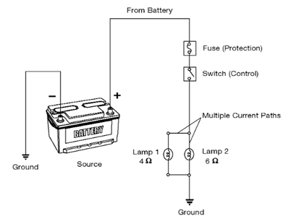
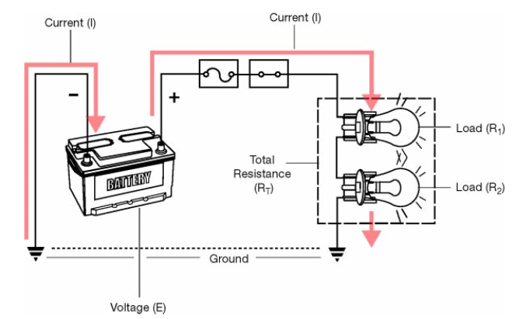
INTRODUCTION TO ELECTRICITY Cont’

Slide 44
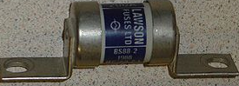
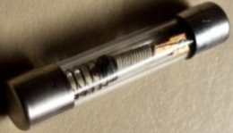
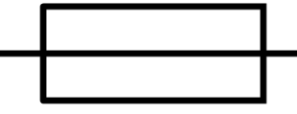
INTRODUCTION TO ELECTRICITY Cont’
Power source: power source is where electrical energy is produced
Protection device: Circuits require protection from excessive current. Excessive current generates heat and can damage the components. Fuses and circuit breakers protect circuits by opening the circuit path when there is too much current or short circuit.
Fuse: fuse is a type of low resistance resistor that acts as a protective device to provide overcurrent protection, of either the load or source circuit. Its essential component is a metal wire or strip that melts when too much current flows through it, interrupting the circuit that it connects. Short circuits, overloading or device failure are the prime reasons for excessive current, and are protected by fuse.

Slide 45
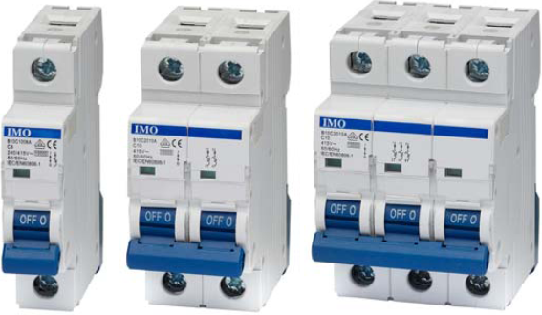



INTRODUCTION TO ELECTRICITY Cont’
Circuit breakers: circuit breaker is an automatically operated electrical switch designed to protect an electrical circuit from damage caused by overload or short circuit. Unlike a fuse, which operates once and then must be replaced, a circuit breaker can be reset (either manually or automatically) to resume normal operation.
Load: The load can be any component that uses electricity to do work likes lamps, motor, …
Control device: The simplest control device is a switch. A switch opens or closes the path for current. Close the switch and current is present to operate the load. Open the switch and current stops. The load no longer operates.

Slide 46
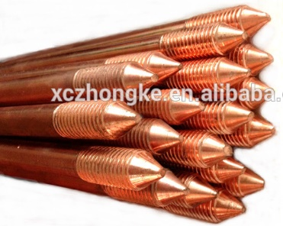
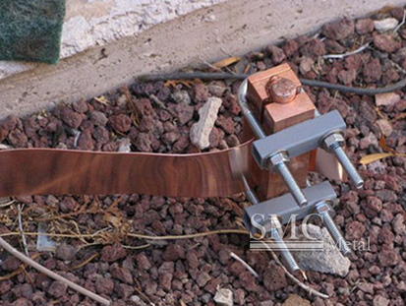
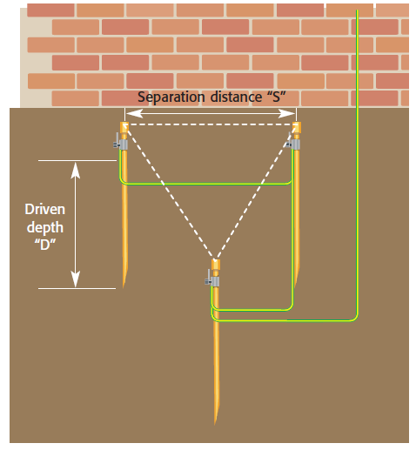
INTRODUCTION TO ELECTRICITY Cont’
Grounding: A conductive connection from all equipment to the earth which acts as a protective measure. It is a safety measure to help prevent people from accidentally meeting electrical hazards.
Ground rods: Ground rods come in many sizes and lengths. Ground rods can be in copper, silver, mercury and gold have high resistance to corrosion.
Multiple earth electrodes: Some ground conditions may warrant many earth rods connected in parallel in order to achieve inacceptable value of earth resistance

Slide 47
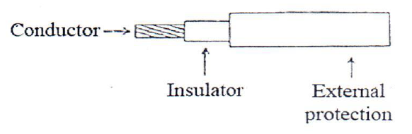
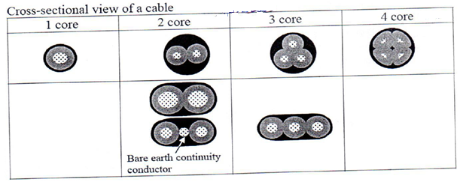

INTRODUCTION TO ELECTRICITY Cont’
Cable

Slide 48
INTRODUCTION TO ELECTRICITY Cont’
  ELECTRIC LIGHT
An electric light is a device that produces light by the flow of electrical current. They are the most common form of artificial lighting and are essential to modern society, providing interior lighting for buildings and exterior light for evening and nighttime activities. Flashlights or "torches", are used for portability and as backups when the main lights fail. The unit of luminous intensity from a light source is the candela (cd). The types of electric lamps are:
Incandescent lamps and
Gas-discharge lamps or fluorescent lamp

Slide 49


INTRODUCTION TO ELECTRICITY Cont’
    INCANDESCENT LAMPS
An incandescent light bulb or incandescent lamp is an electric light which produces light with a filament wire heated to a high temperature by an electric current passing through it, until it glows. The hot filament is protected from oxidation witglass or quartz bulb that is filled with inert gas.

Slide 50

INTRODUCTION TO ELECTRICITY Cont’
    FLUORESCENT LAMP
A fluorescent lamp or a fluorescent tube is a low-pressure mercury-vapour gas-discharge lamp that uses fluorescence to produce visible light. An electric current in the gas excites mercury vapour which produces short-wave ultraviolet light that then causes a phosphor coating on the inside of the bulb to glow. A fluorescent lamp converts electrical energy into useful light much more efficiently than incandescent lamps.

Slide 51


INTRODUCTION TO ELECTRICITY Cont’
Fluorescent lamp in starting
fluorescent lamp after starting

Slide 52




ELECTRICAL HAND TOOLS
Combination Plier
Side Cutter Plier
Long Nose Plier
Wire Stripping Plier

Slide 53





ELECTRICAL HAND TOOLS Cont’
Crimp Grip Pliers
Screw driver
Electrical knife

Slide 54





ELECTRICAL HAND TOOLS Cont’
Voltage tester
Multimeter
Hammer

Slide 55



ELECTRICAL HAND TOOLS Cont’
Tap mesure
Spirit Levels
Spanner

Slide 56
ELECTRICAL DIAGRAMS
Electrical circuit diagram: is a conventional representation of electrical installations that show in simple field way the relation between different parts of installation and the means used to establish these relations. An electrical diagram consists of:
Symbols: the symbols represent elements of an installation (machines or parts of machines and components).
Lines: represent electrical or mechanical connections. Lines can be dashed or doted and they can be used to indicate elements group.
Marks: these show identification of installation of machine and components of parts of machines they show number of conductor that are directed to terminals of machines and components.

Slide 57
ELECTRICAL DIAGRAMS Cont’
  TYPES OF DIAGRAM
  Explication diagram
They make easier to the user to understand the functions of the installation; they give a simplified representation of parts and components.
    Realisation diagrams
This is used as a guide in practice or in verification of connection of an installation. They identify all connections or group of connections that we need to realise or control.

Slide 58
ELECTRICAL DIAGRAMS Cont’
  MODES OF DIAGRAMS
Architectural diagram: This diagram shows position of each element in room according to the indication of owner. This is used by the entrepreneur or architectures
Circuit diagram: In this kind of diagram symbols are organised in such way each circuit will be almost as a line. This kind of diagram make easier understand the function of circuit.
Wiring diagram: This is an illustration describing how electrical circuits are arranged and connected. They offer a logical representation of the wiring layout. It shows the components of the circuit as simplified shapes. A wiring diagram usually gives more information about the relative position and arrangement of devices and terminals. This kind of diagram requires hand work of drawing.
Schematic diagram: In this kind of diagram is used to simplify the task of drawing. Unique line is used to represent a set of many conductors in one pipe.

Slide 59

ELECTRICAL DIAGRAMS Cont’
ELECTRICAL SYMBOLS

Slide 60

ELECTRICAL DIAGRAMS Cont’

Slide 61


ELECTRICAL DIAGRAMS Cont’

Slide 62

ELECTRICAL DIAGRAMS Cont’

Slide 63


ELECTRICAL DIAGRAMS Cont’

Slide 64
ELECTRICAL WORKSHOP TECHNOLOGY
THANK YOU FOR YOUR ATTANDENCE

